Slide 1
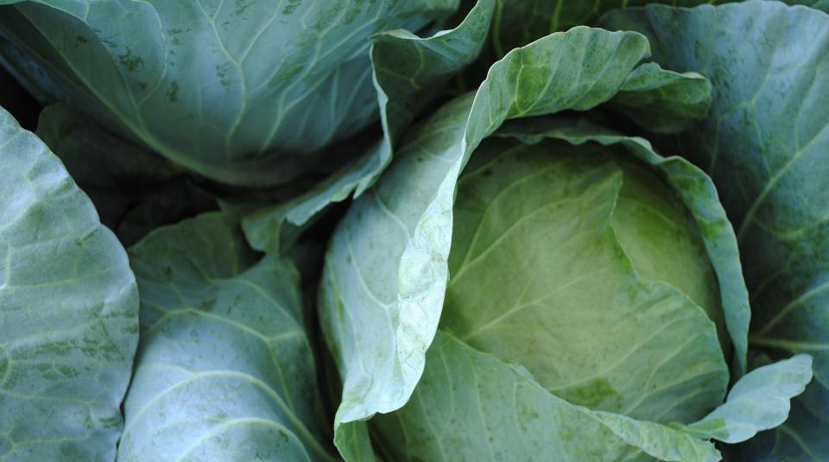
Sustainable Agriculture Policy Progress in the Farm Bill & Beyond
Ferd Hoefner, National Sustainable Agriculture Coalition
Martha Noble, National Sustainable Agriculture Coalition
Notes:
Just up at the start

Slide 2
Farm Bill Basics
Comprehensive authorizing legislation impacting federal food and farm policy
Written by the House and Senate Agriculture Committees
Reauthorized every 5-7 years
2008 Farm Bill Expired Sept. 30, 2012 – partial extension in place until Sept. 2013!
Nearly a trillion dollars in funding over 10 years
Notes:
So. All that said… you’re here to hear about the farm bill, right?
MARTHA

Slide 3
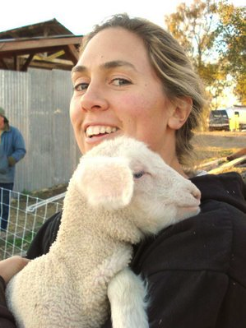
What’s in the Farm Bill?
Current “Titles” or Chapters:
I: Commodity
II: Conservation
III: Trade
IV: Nutrition
V: Credit
VI: Rural Development
VII: Research
VIII: Forestry
IX: Energy
X: Horticulture and Organic
XI: Livestock
XII: Crop Insurance
XIII: Commodity Futures
XIV: Miscellaneous
XV: Trade and Tax Provisions
Photo Credit: California FarmLink
Notes:
Graph – farm bill titles – a few examples of the kinds of things in each one. Key programs.
MARTHA

Slide 4
Quiz!
Can you rank these federal programs in order from most to least expensive?
Conservation programs
Crop insurance subsidies
Supplemental Nutrition Assistance Program (formerly food stamps)
Commodity subsidies (including direct payments)
Notes:
QUIZ: turn to your neighbor, rank these titles in order of most to least expensive
5 minutes – then we’ll report back
anyone wanna take a shot??
SARAH OR MARTHA

Slide 5
Where’s the Money?
10 year budget estimates for the 2013 bill before cuts:
$760 billion: Supplemental Nutrition Assistance Program
$87 billion: Crop insurance subsidies
$68 billion: Commodity subsidies
$64 billion: Conservation programs
Notes:
Pretty pricey, right? Let’s break it down visually
MARTHA

Slide 6
Where’s the Money?

Slide 7
Where’s the Money

Slide 8
So… Where are we Now?
Notes:
TRANSITION SLIDE – SARAH
So yeah… it matters.
Where are we with the farm bill right now?
Long story short: it’s stalled.

Slide 9
The Legislative Process
Where we’re at right now
Authorization
Appropriation
Implementation
Evaluation
Notes:
MARTHA?

Slide 10
What’s Going On? (1)
Senate passed its version of the 2012 Farm Bill in the summer of 2012
House Agriculture Committee passed its version of the 2012 Farm Bill this summer
But the House of Representatives leadership declined to bring the committee’s bill to the floor – the Farm Bill reauthorization process stalled
Meanwhile, the old 2008 bill EXPIRED on October 1, 2012
Notes:
MARTHA?

Slide 11
What’s Going On? (2)
Congress passed a partial extension of the 2012 Farm Bill until Sept. 30, 2013 with the fiscal cliff bill in January 2013.
Sustainable food and agriculture programs included in the extension provision up until the last minute but . . .
Final deal on Farm Bill extension:
No funding for many key sustainable agriculture programs “stranded programs”
No reforms for farm subsidies, even direct payment subsidy eliminated in both House and Senate Farm Bills

Slide 12
Stranded Programs and Dollars
Farm Bill Title and Programs | 2012 Farm Bill Level for 2013 | Stabenow/Lucas 12/29 Level for 2013 | Biden-McConnell 12/31 Final Level
Conservation
Voluntary Public Access | $8 million | $10 million | $0
CRP-Transition Incentive Program | $10 million | $0 | $0
Rural Development
Rural Microenterprise Assistance | $3 million | $3 million | $0
Value-Added Producer Grants | $10 million | $3 million | $0
Research
Organic Research and Extension | $20 million | $20 million | $0
Specialty Crop Research Initiative | $25 million | $50 million | $0
Beginning Farmer Development Program | $17 million | $19 million | $0
Energy
Rural Energy for American Program | $48.2 million | $51 million | $0
Biomass Research and Development | $26 million | $33.6 million | $0
Biomass Crop Assistance Program | $38.6 million | $38.6 million | $0
Specialty Crops and Organic
Farmers Market Promotion Program | $20 million | $10 million | $0
National Organic Certification Cost Share | $11.5 million | $5 million | $0
Organic Data Initiative | $1 million | $1 million | $0
Miscellaneous |  |  | $0
Socially Disadvantaged Farmers Program | $10 million | $20 million | $0
TOTAL | $489 million | $477 million | $0

Slide 13
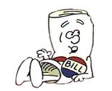
Paths Forward for a Farm Bill
Roll the dice on the options:
Best Outcome - Congress passes a full 5-year farm bill in 2013 – with adequate funding for sustainable agriculture programs and nutrition programs
Congress passes another extension – for 1-2 years – and kicks the can down the road even farther into the future
Terra incognita: some other as-yet
unknown possibility!
Notes:
MARTHA?

Slide 14
Act Now to Support Key Marker Bills
Farm Program Integrity Act – S. 281
Protect Our Prairies Act – H.R. 686
* Local Farms, Food, & Jobs Act – April 9 – House and Senate
* Beginning Farmer & Rancher Opportunity Act – Apr 16 – House& Senate
Upcoming:
Conservation Stewardship and Family Farms Act – House
Minority Farmer Act - Senate
Urban Agriculture Act - House

Slide 15
Support Needed for Key Programs
Beginning Farmers & Ranchers /
Socially Disadvantaged Farmers and Ranchers
Local & Regional Food Systems
International Food Aid
Conservation and Renewable Energy
Notes:
What does the farm bill expiration mean for sustainable ag?? And for work on the ground?
TRANSITION SLIDE

Slide 16
Beginning Farmers & Ranchers / Socially Disadvantaged Farmers Ranchers
Beginning Farmer & Rancher Development Program (BFRDP)
Provides grants and assistance to organizations that provide training and technical assistance to beginning farmers and ranchers.
Why is it important?
Average age of U.S. farmers and ranchers is between 57 and 59 years old.
Fastest growing group of farmers and ranchers are those over 65 years old.
For every farmer under 25 years of age, there are 5 farmers over 75 years old

Slide 17
Beginning Farmers & Ranchers / Socially Disadvantaged Farmers & Ranchers
Outreach and Technical Assistance for Socially Disadvantaged Farmers & Ranchers (Section 2501 Program):
Grants and assistance to educational institutions and organizations to assist minority farmers in owning and operating farms and participating in agricultural and USDA-specific programs.
Why is it important?
Strengthens families and communities
Redress for past history of USDA discrimination against SDA farmers and ranchers

Slide 18
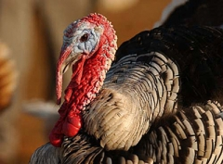
Local and Regional Food Systems
Skyrocketing consumer demand for local food that agricultural producers and entrepreneurs are striving to meet
Despite these opportunities, significant infrastructure, marketing, and information barriers are limiting growth

Slide 19
Local & Regional Food Systems
A number of “stranded programs” have helped catalyze emerging markets, new initiatives, and community-based efforts that benefit farmers and communities through competitive grants, e.g.
Beginning Farmer and Rancher Development Program (BFRDP)
Value Added Producer Grant (VAPG)
Specialty Crop Block Grant (SCBG) (funding to states)
National Organic Certification Cost Share Program

Slide 20
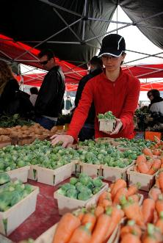
Example – Farmers’ Markets
Farmers Market Promotion Program
- Assistance to establish and expand direct
to consumer markets.
- Focus on underserved communities
“Food Deserts”
- New markets for small/mid-sized farmers
Senior Farmers Market Program
Provides grants to states and tribes to provide low-income seniors with coupons for use at farmers’ markets, community supported agriculture farms, etc.
Farmers’ Market Electronic Benefit Transfer Program
Facilitates use of SNAP electronic benefits card at farmers’ markets.
Notes:
-Improve marketing outlets by creating a level playing field for electronic benefit transfer Among vendors
- Improve the ability of schools to procure local foods and fresh produce in lieu of participation in traditional commodity programs
- Improve the ability of Rural Development programs that fund infrastructure and development to fund local and regional food systems

Slide 21
Connecting the Dots
Defending and improving SNAP’s structure, benefits and eligibility can yield increased income for farmers
Incentivizing healthy, local food purchases similarly provides more opportunities for farmers to sell their produce
Healthy food financing establishes additional avenues through which farmers can market
Notes:
The work that I have described on behalf of NSAC and Southern SAWG is part of our larger agriculture and food system. By increasing demand for fresh, local products, and by facilitating market opportunities, not only do low-income Americans benefit, but so too do our nation’s farmers. Together, we envision a healthy, food-secure population supporting a vibrant and economically sustainable food system.

Slide 22
International Aid and Local Food
The Farm Bill provides funding for international food aid:
Food for Peace: FY2012 $1.2 billion
McGovern-Dole International Food for Education and Child Nutrition: FY2012 $200 million
Support funding for international food aid
Reform international food aid with addition of Local and Regional Procurement requirements.

Slide 23
Conservation Stewardship Program
Comprehensive conservation assistance to whole farms and working lands to resolve particular resource concerns in a given location.
Farmers can augment good current conservation efforts with payments for maintenance, expansion, and addition of new conservation practices.
Includes grazing land, rangeland, pasture, cropland, specialty crops, orchards, vineyards, dairies, tree farms, private non-industrial forests, aquaculture, truck farms, and more.

Slide 24
CSP Goals
Improving soil, water and air quality
Providing increased biodiversity and wildlife and pollinator habitat
Sequestering carbon in the soil and reducing greenhouse gas emissions
Conserving water use and energy use
NRCS Photo

Slide 25
CSP Basics
Nationwide sign up
State, region, or watershed priorities (targeted within comprehensive program)
Must exceed Stewardship Threshold on at least one priority to enroll and at least one more during contract
Must add more conservation to renew

Slide 26
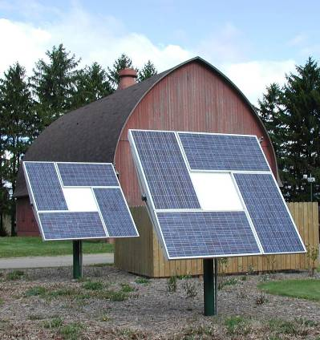
Rural Energy for America Program
Provides financial assistance, both grants and loan guarantees, to farmers and rural small businesses for energy efficiency and renewable energy projects.
Stranded program not included in extension of 2008 Farm Bill.
USDA issued notice in March 2013 that last funding available in 2013 is $3 million.
NRCS Photo
Notes:
26
Small, localized projects, residential applications, some corporate buildings; very little commercial energy production
Soldiers Grove—the Little Town that Could—The Solar Village—not sure that it is still going strong

Slide 27
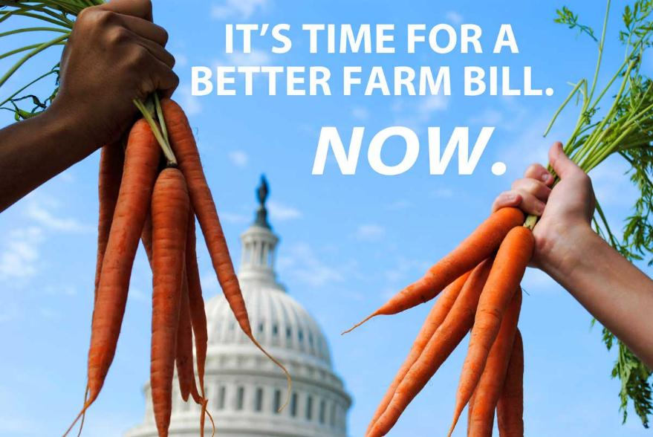
The Farm Bill
Notes:
Switch to sarah / grassroots

Slide 28
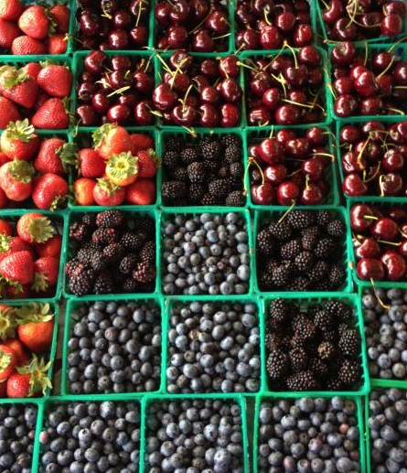
Questions?
Ferd Hoefner
Policy Director
fhoefner@sustainableagriculture.net
202-547-5754
Martha Noble
Senior Policy Associate
mnoble@sustainableagriculture.net
202-547-5754
http://www.sustainableagriculture.net
Notes:
CLOSING

